Slide 1
Spatiotemporal modelling & automated in-situ sensors to monitor Harmful Algal Blooms(HABs) Case Study-Lake Victoria
Presenter:
Name: OKELLO, JACOB OKOMO
Reg. No: ENC222-0149/2017

Slide 2
Introduction
Toxic Cyanobacteria-rich Harmful Algal Blooms (CyanoHABs) , a phenomenon which turns water bodies dark blue-green due to eutrophication; potentially harming humans and animal, e.g., Unsightly nuisance, acute liver damage when ingested, irritation, massive fish deaths, etc. (Santoleri et al., 2003), WHO
Development, stability, and density of the phenomenon are related to some environmental factors Lake Surface Water Temperature (LSWT), Lake Surface Air Temperature (LSAT), Sea Surface Temperature (SST) & adequate nutrient concentration, enough sunlight, warm temperatures (Tang et al, 2006)
Hence, quantifying the spatial distributions of CyanoHABs in L. Victoria is of great significance, which requires high spatiotemporal resolution monitoring. (Sitoki et al., 2012)
There however exists that niche to support the space observations with a near-real time geointelligent in-situ monitoring and reporting system.

Slide 3
Problem statement
The rapidly escalating demographics along L. Victoria riparian reserves has negatively impacted water quality through deposits of agricultural, industrial runoff and sewer refuse eutrophicating the said region. (Burkholder et al., 2006; MOH)
Deterioration in water quality initiates ecosystem conflicts, poor economic growth, reduced tourism, poor water quality furthermore baring achievement of SDG 6 & 14- Clean Water and Sanitation. (Hecky et al., 2010)
Coupling wide spread spatiotemporal monitoring, and automated in-situ sensors will play a big deal in return. This would inform the Govt. and the general public the affected zones, calling for immediate remedy actions.

Slide 4

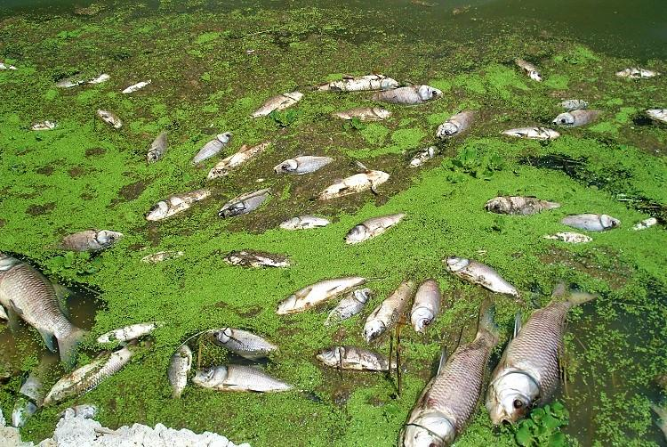
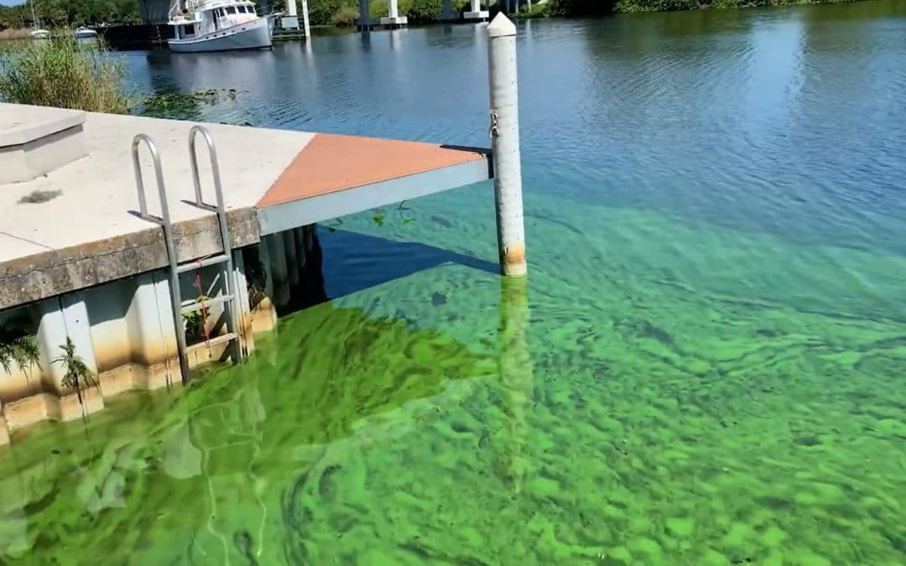
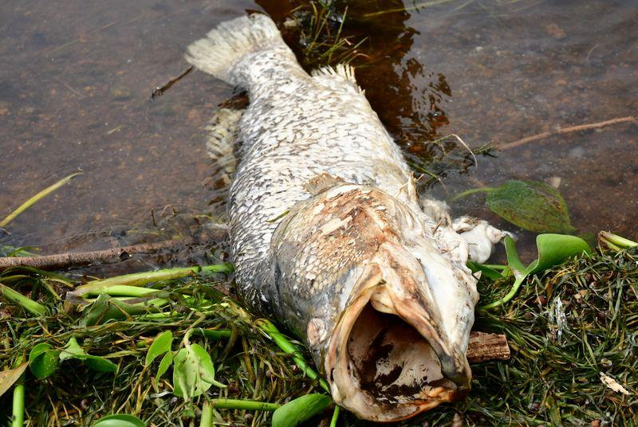
Justification
Image Sources: Standard Media KE, KMFRI, allAfricawaters

Slide 5
General and specific objectives
To detect, monitor and report the occurrence of Harmful Algal Blooms(HABs) and Cyanobacteria in Lake Victoria.
To monitor chlorophyl-a(chl-a) concentration from L8 OLI images.
To monitor Lake Surface Water Temperature(LSWT) from L8 TIRS images as another HAB indicator in L. Victoria.
To develop automated Internet of Things (IoT) in situ sensors, Applicable in near real-time to monitor and report geo-tagged Water quality data.

Slide 6
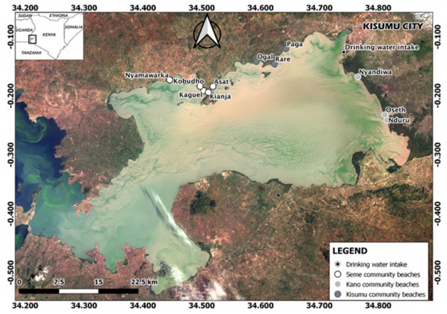
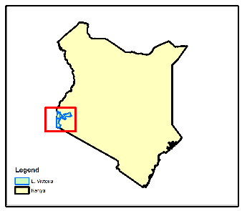
Study Area
NYANZA GULF
Homabay

Slide 7
Overall Methodology : Data and Materials
Data Type | Source | Role/Use
Landsat 8 OLI (30m, 16 days) | Google Earth Engine (2015-2021) | Spatiotemporal HAB Monitoring
Landsat 8 TIR (100m, 16 days) | Google Earth Engine (2015-2021) | Lake Surface Water Temperature Monitoring(LSWT)
Meteorological Data | Kenya Marine & Fisheries Research Institute-KMFRI (2015-2021) | Water Quality assessment
Shapefiles | Geodatabase of Global Administrative areas- GADM | Delineate the Study area
In-Situ Data | In-situ Sensors 2021 Onwards | Continued In-Situ Algal Monitoring
Tool/Material | Role | Availability
Google Earth Engine (GEE) | Geocomputation & Processing | Freely Available
QGIS/ArcMap, R & Python | Further Analysis & Maps | Free
Microcontroller & Sensors | In-Situ data Monitoring | Local Purchase
KiCAD | Design the Schematics & basic Circuits | Free & Open source

Slide 8
Atmospheric Corrections
TIRS Data
Landsat 8 images
Geometric Corrections
OLI Data
TIRS B10
B5 NIR
B4 RED
B3 GREEN
B2 BLUE
NDVI
TOA DN to At-Sensor Radiance(Lλ)
Proportional of Vegetation(Pv)
Basic Chl-a algorithms
At-Sensor Spectral Radiance to Brightness Temp (Tb₁₀)
Lake Surface Emissivity (LSE)ε
CDOM/In-situ
Estimate Lake Surface Water Temp (LSWT)
Objective 2
Objective 1
Threshold
Below
Above
Spatiotemporal Monitoring
Process validation

Slide 9

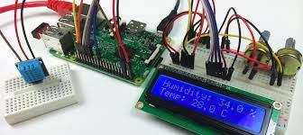


Overall methodology
Start
IoT Gateway
Ensure a secure connection via SSh
Upload in-situ data to reporter
Upload in-situ data to Processor
GPS
LWST
LSAT
No
In-situ data > Temp. threshold
Objective 3

Slide 10
Expected Results
Chlorophyl-a Geographical Maps associating the occurrence of the Harmful Algal Blooms and Cyanobacteria.
Lake Surface Water Temperature(LSWT) Maps associating the presence of HABs.
Autonomous system that monitors and reports geo-tagged water quality data in near-real time from the in-situ sensors.

Slide 11
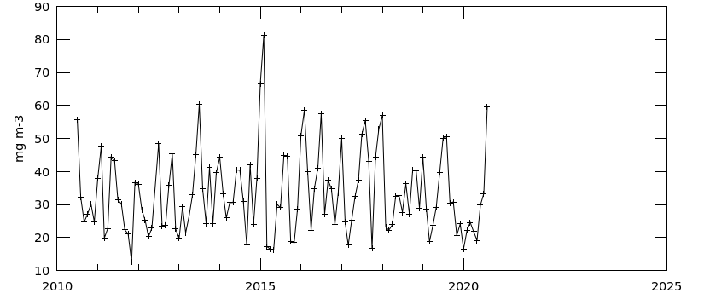
SAMPLE RESULTS: Time series Average of Chl-a conc. monthly 4-Km MODIS L3m

Slide 12
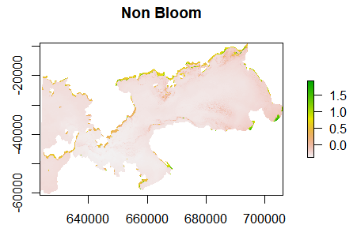
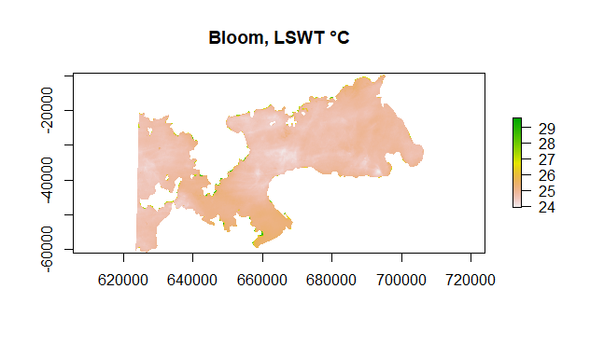
L8 2015: No Bloom Reported (cl-g map) Vs LSWT Map at Bloom Event.

Slide 13
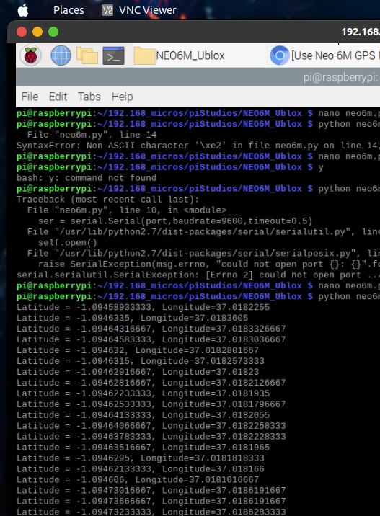
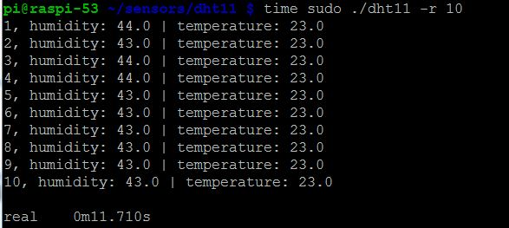
Obtaining GPS Location, Water Temp and Relative Humidity from Sensors.

Slide 14
Project Timeline
 | June - July | August | Sep | Oct | Nov | Dec
Chl-a | Literature Rev (Restructure) | Data Acquisition Preliminary results | Chl-a spatiotemporal Maps
LSWT | Literature Rev (Restructure) |  | LSWT spatiotemporal Maps
IoT | Literature Rev. Acquire all sensors | Unit tests | Long Range comm. |  | Full Data Acquisition and Dissemination

Slide 15

Thank you for your attention! Questions?

